Slide 1
COMPARATIVE EMBRYOLOGY
NAME:
DATE:
INSTITUTION AFFILIATIONS:

Slide 2
Introduction
Aristotle became the first person to undertake the research comparative development anatomy. He recognized the various way the organisms are born which included; oviparity, viviparity, and ovoviviparity.
The study of various types of organism in comparison to one another in the fetal stages.
The study of comparative embryology has been used by the scientists in information gathering evolution.

Slide 3
Principles of comparative embryology
Before the appearance of specialized features, the development of the major features take place.
The most specific feature of embryo appears before the general features develop.
Although these embryos needs to pass through other forms, they become separated from them.
The resemblance of the embryo of higher animals is the same as embryo, not the same as the adults.

Slide 4
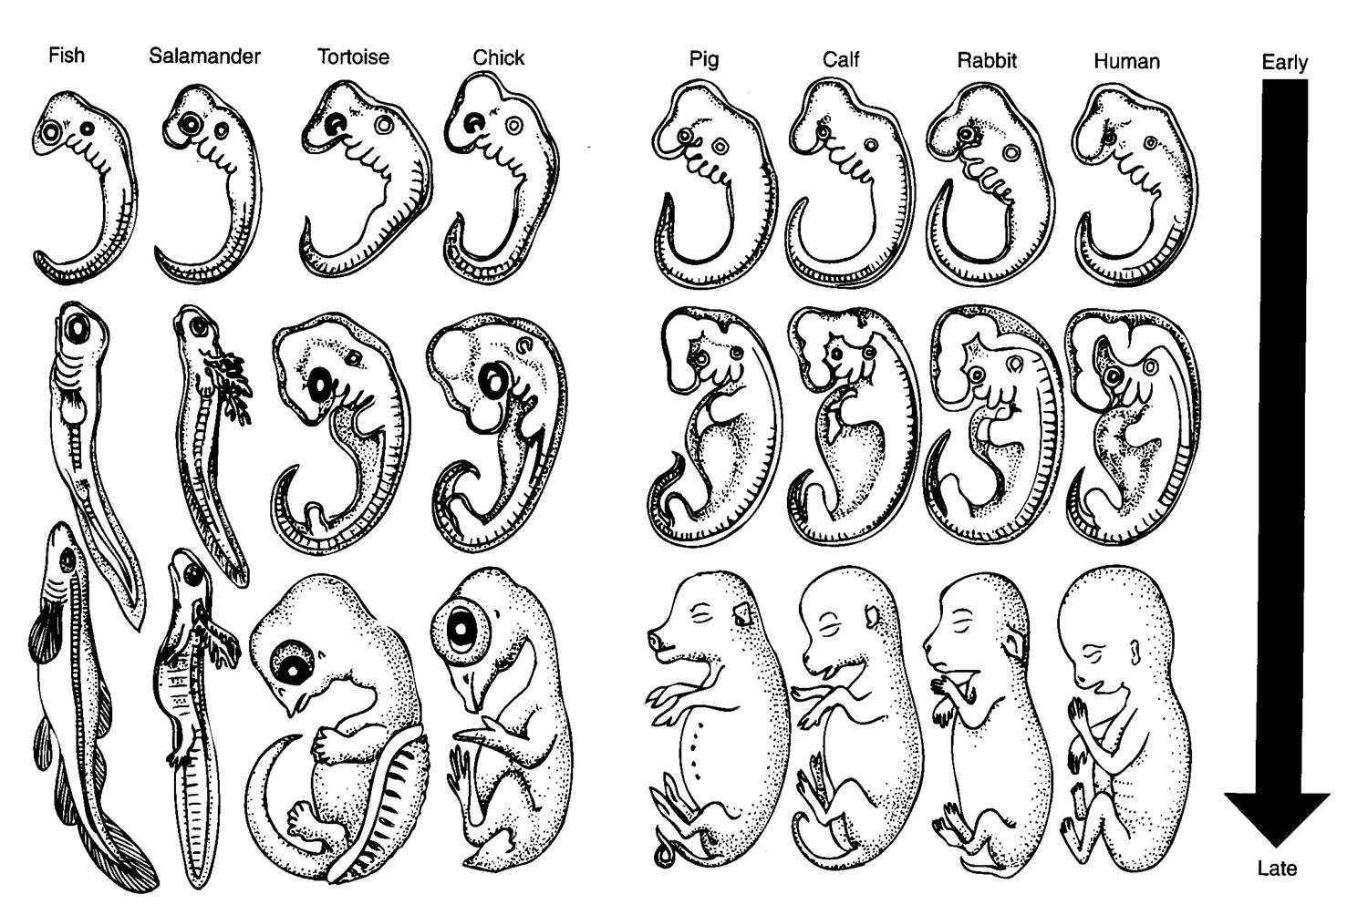
IMAGES OF EMBRYOS
In this image, the development of an embryo, the general characteristics features before the specialized ones. It shows the progressive development of the embryo.
Notes:
http://evolutionexplained.blogspot.com/2011/12/evidences-comparative-embryology.html

Slide 5
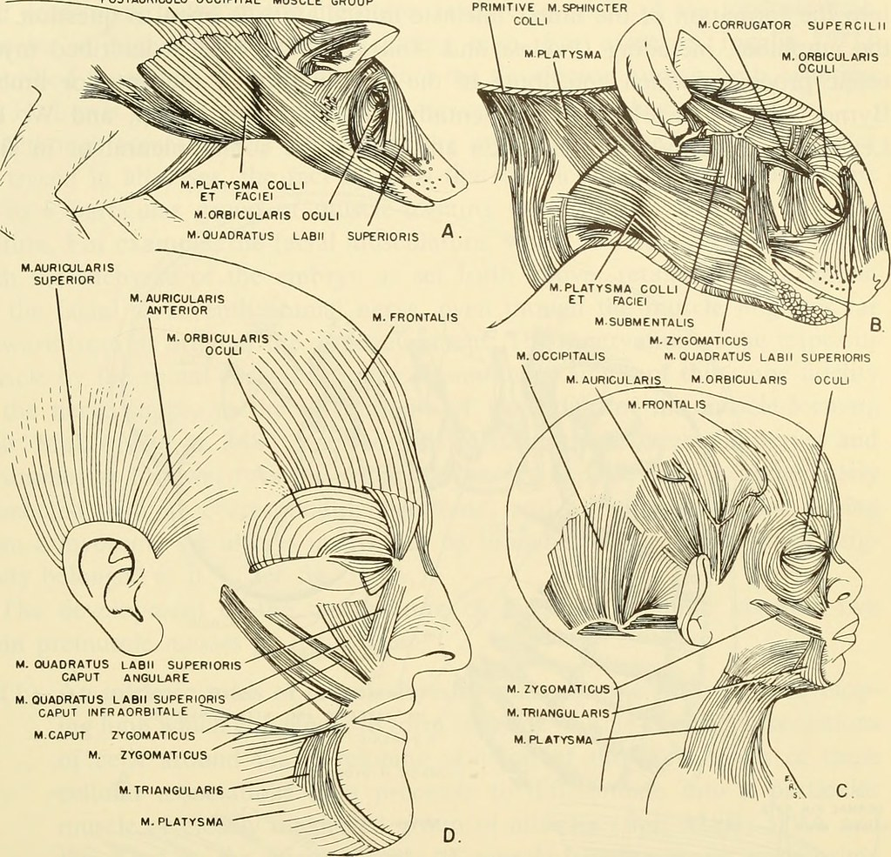
IMAGE TWO
Image from page 744 of "Comparative embryology of the vertebrates; with 2057 drawings and photos. grouped as 380 illus" (1953)
Notes:
https://www.flickr.com/photos/internetarchivebookimages/20670680115/

Slide 6
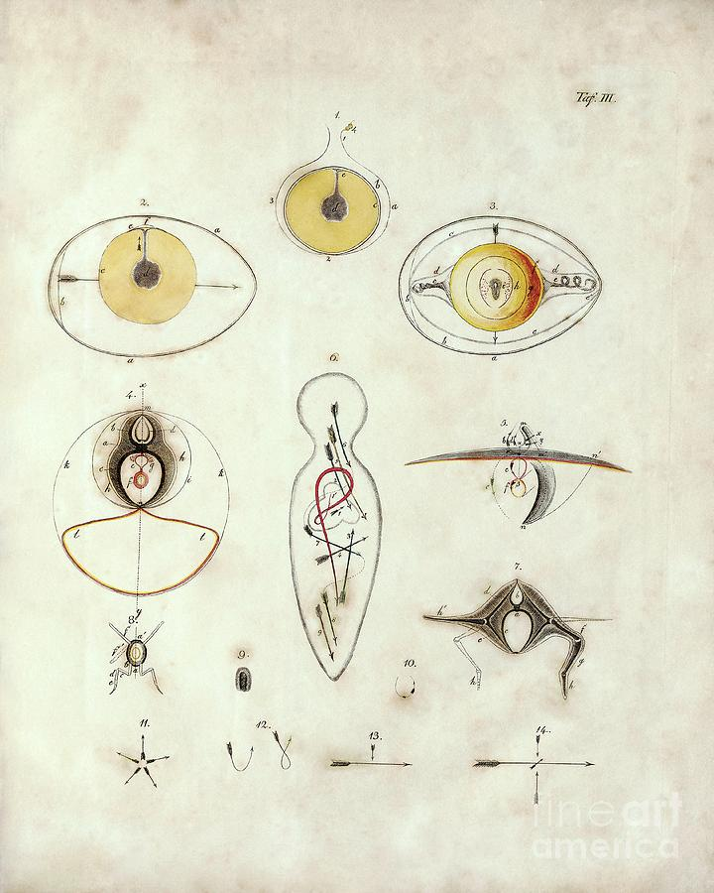
IMAGE THREE
Description
Von Baer, comparative embryology. The picture above indicates yolk and embryo development in chicken eggs. The four images at the center indicate idealized aspect of vertebrate embryo.
Notes:
https://fineartamerica.com/featured/1-comparative-embryology-by-von-baer-library-of-congress-rare-book-and-special-collections-divisionscience-photo-library.html

Slide 7
Annotating bibliography
https://fineartamerica.com/featured/1-comparative-embryology-by-von-baer-library-of-congress-rare-book-and-special-collections-divisionscience-photo-library.html
  This is a reserach done by a scientist from Germany in between (1792-1876) by Karl Ernst von Baer
https://www.flickr.com/photos/internetarchivebookimages/20670680115/
  Written by Nelsen, Olin E. in 1898, published by new York, Blakiston.

